Slide 1
Predicting customer buying behaviour
British airways customer buying behaviour
01-12-2022

Slide 2
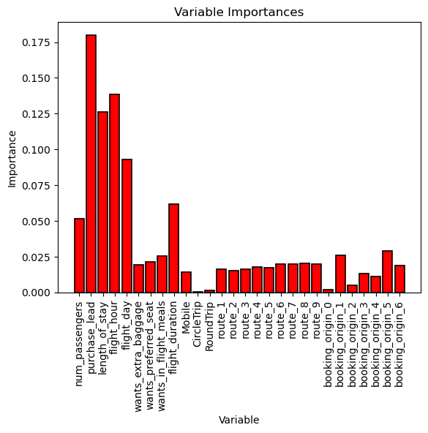

Insights
The accuracy of the model which uses a Random Forest Classifier is : 85.5 %
We can infer from the chart the following features and their importance in the overall prediction:
Purchase_lead : 18 %
Route (Combined ) : 20 %
Flight_hour : 14 %
Length_of_stay : 13 %
Booking_origin (Combined) : 11 %
Flight_day : 9 %
Flight_Duration : 6 %
Num_passengers : 5 %

